Slide 1

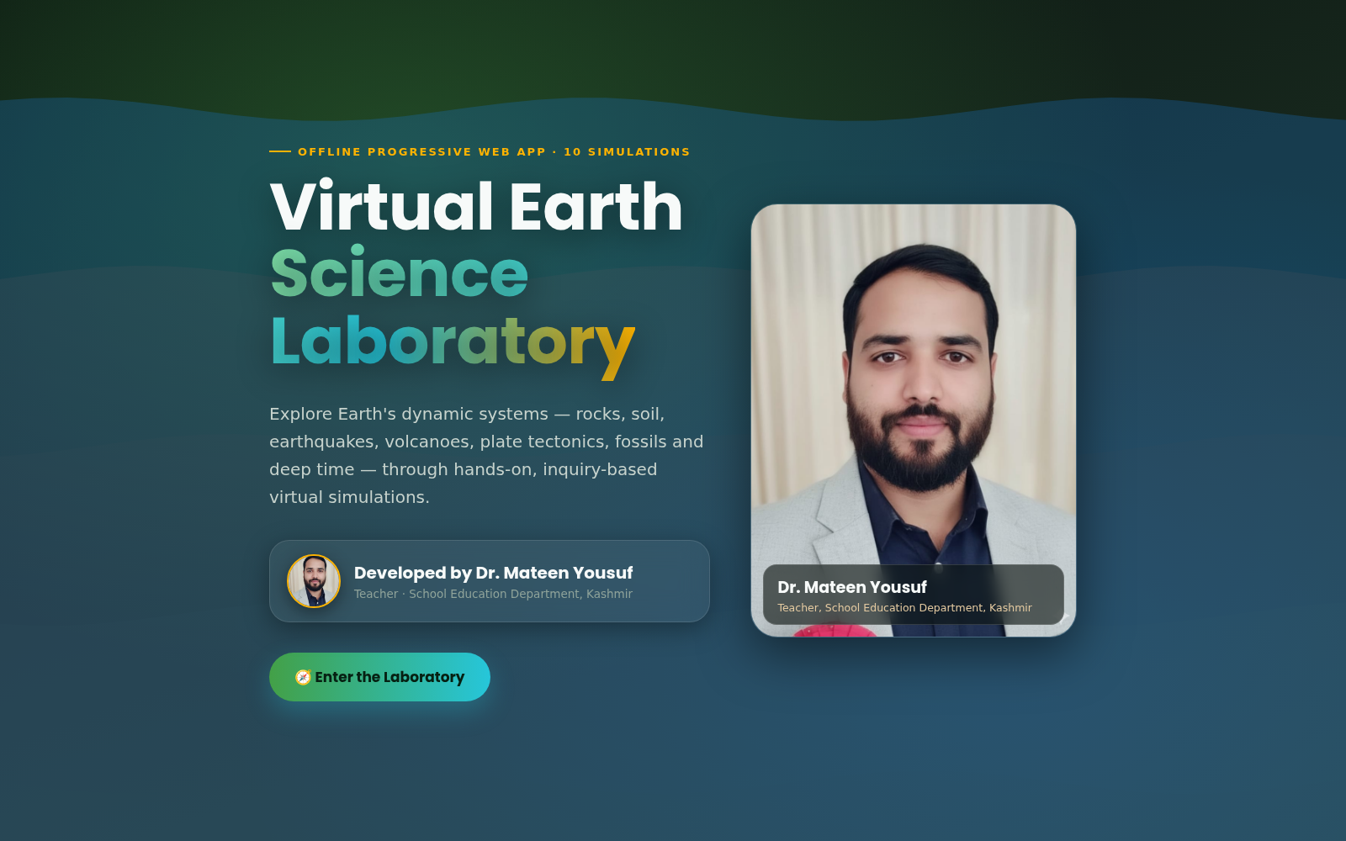
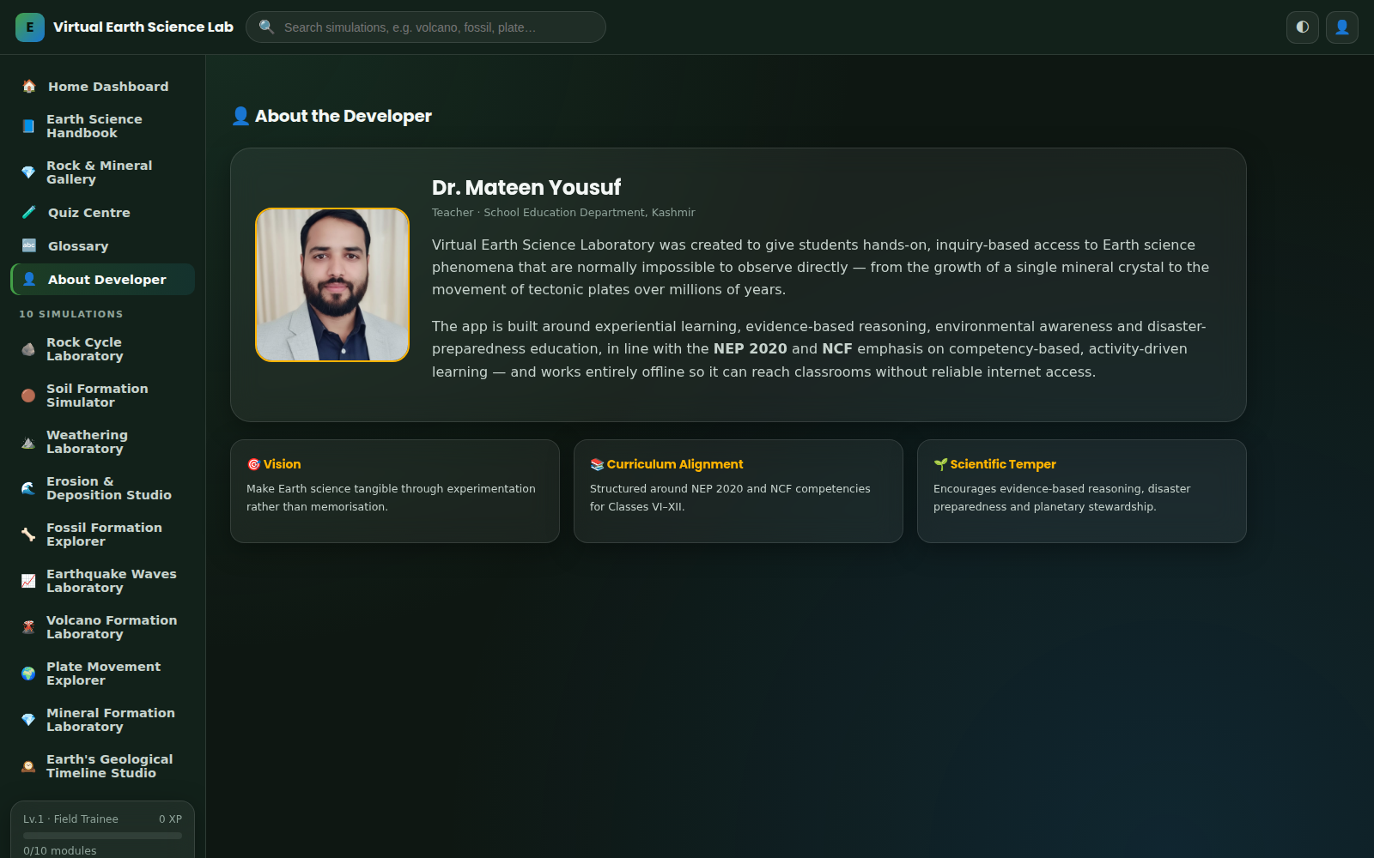

OFFLINE PROGRESSIVE WEB APP · 10 INTERACTIVE SIMULATIONS
Virtual Earth Science Laboratory
A presentation deck for teachers, students and curriculum reviewers — what the app is, how to use it, and a full walkthrough of all ten simulations.
The title / splash screen students see first
Developed by Dr. Mateen Yousuf Teacher, School Education Department, Kashmir
The in-app About Developer page

Slide 2
AGENDA
What we’ll cover
01
What is the app
02
Key features
Mission, audience and how it fits classroom teaching
Everything packed into the offline experience
03
How to use it
04
The 10 simulations
Navigating the app and every simulation’s common layout
A full walkthrough of every interactive lab, with screenshots
05
Reference tools
06
Getting started
Handbook, gallery, glossary, quiz centre and gamification
Curriculum alignment and installing the app offline
VIRTUAL EARTH SCIENCE LABORATORY
02

Slide 3
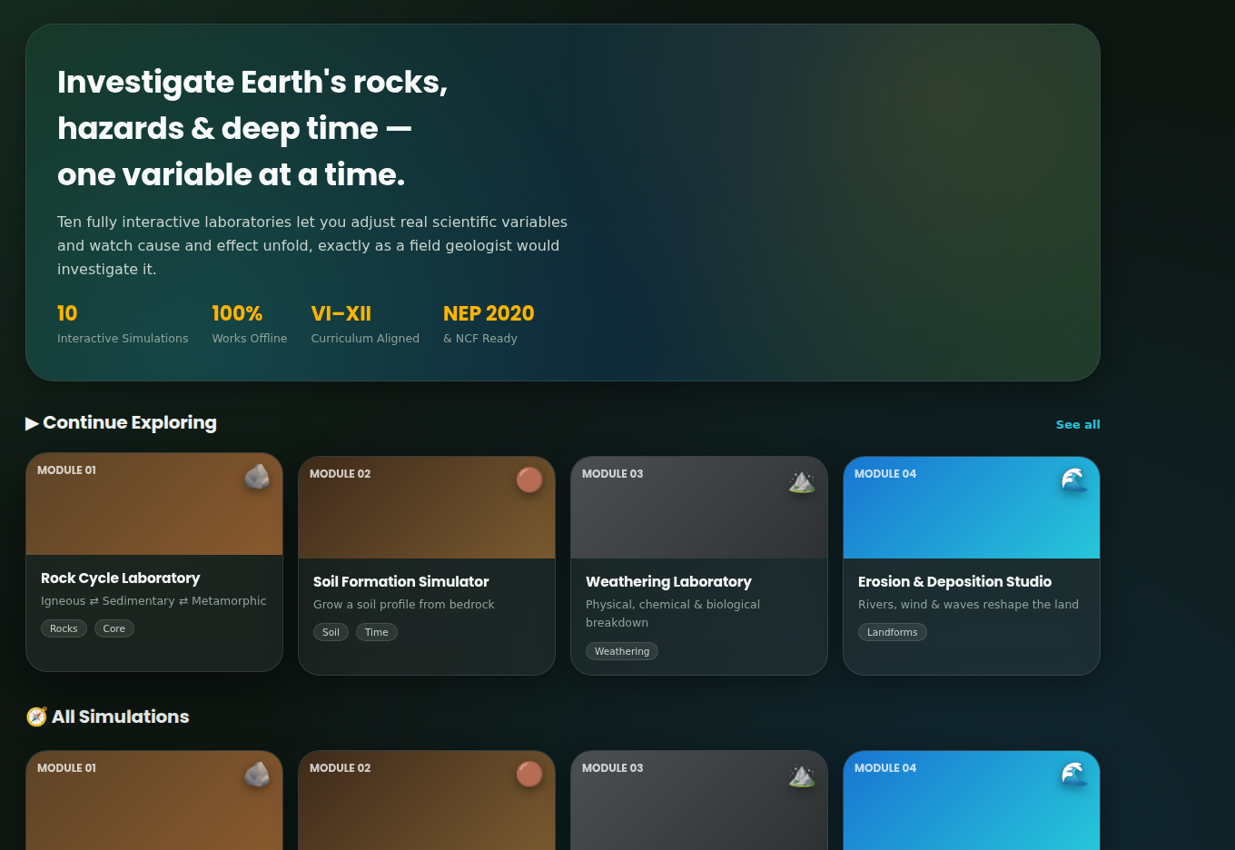
OVERVIEW
Investigate Earth’s dynamic systems — one variable at a time
Virtual Earth Science Laboratory is a fully offline Progressive Web App containing ten scientifically accurate, hands-on simulations covering rocks, soil, weathering, erosion, fossils, earthquakes, volcanoes, plate tectonics, minerals and 4.6 billion years of geological time. Instead of reading about geology, students adjust real variables — heat, pressure, magnitude, rainfall — and watch cause and effect unfold on screen, exactly as a field geologist would investigate it.
Home Dashboard — the app’s starting point
10
100+
100%
VI–XII
Interactive Simulations
Adaptive Quiz Questions
Works Fully Offline
Curriculum Coverage
Built by a classroom teacher, for classrooms without reliable internet.
VIRTUAL EARTH SCIENCE LABORATORY
03
Title screen with developer introduction

Slide 4
KEY FEATURES
Everything packed into one offline app
⚙
⚡
★
10 Interactive Labs
Fully Offline PWA
XP & Gamification
Real adjustable variables driving live canvas visualisations — not animations or slideshows.
No backend, no APIs, no login. A service worker caches every asset for one-tap offline use.
Levels, geologist ranks, completion badges and streaks reward consistent investigation.
?
▤
⌘
Adaptive Mini-Quizzes
Data Tables & Graphs
Handbook, Gallery & Glossary
Every simulation ends with 5 scored questions and instant, explained feedback.
Each lab logs observations automatically into exportable tables and live charts.
Ten reference chapters, a rock/mineral gallery and a searchable glossary back every lab.
VIRTUAL EARTH SCIENCE LABORATORY
04

Slide 5
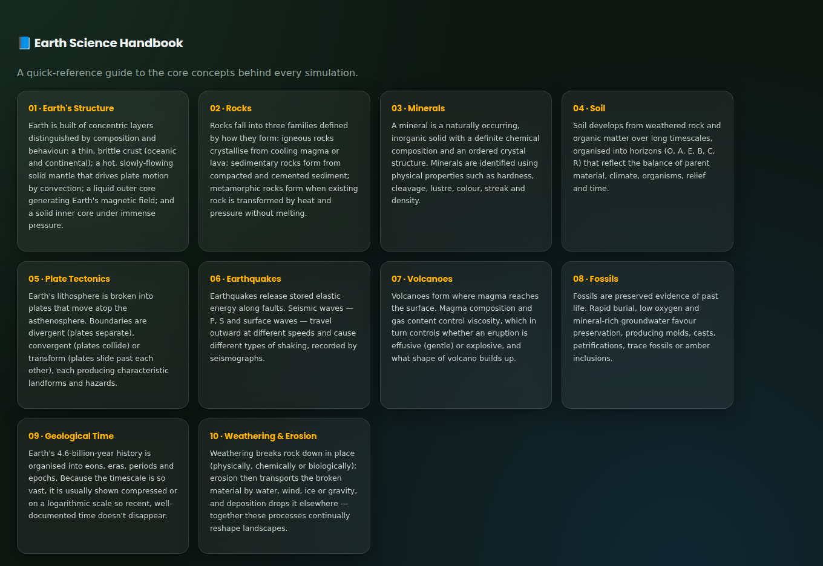
AUDIENCE
Built for classrooms across Classes VI–XII
Designed as a single shared tool that scales from a middle-school introduction to rocks, all the way to exam-focused revision of plate tectonics and seismology.
Students, Classes VI–XII
Classroom teachers & DIET faculty
Science and Geography clubs
Smart-classroom / smart-board sessions
Science exhibitions and fairs
Competitive exam aspirants
Every lab is backed by the Earth Science Handbook — ten reference chapters mapped to the syllabus
VIRTUAL EARTH SCIENCE LABORATORY
05

Slide 6
UNDER THE HOOD
100% offline by design
Built as a Progressive Web App with HTML5, CSS3 and vanilla JavaScript — deliberately with no React, backend, API or cloud dependency, so it runs reliably in schools without steady internet.
1
2
3
4
Open once
Service worker caches everything
Install to home screen
Runs with zero connection
→
→
→
Load the app in any modern browser the first time — online or from a shared file.
HTML, CSS, JavaScript, icons and the developer photo are stored on-device automatically.
A single tap adds a real app icon — no browser bar, no app-store account.
Every simulation, quiz, chart and reference page keeps working with the network off.
VIRTUAL EARTH SCIENCE LABORATORY
06

Slide 7
HOW TO USE — PART 1
Getting from the title screen to a simulation
1
2
3
4
Open the app
Enter the laboratory
Browse or search
Open any simulation
The title screen introduces the lab and its developer, Dr. Mateen Yousuf.
One tap on “Enter the Laboratory” loads the Home Dashboard.
Scroll the ten module cards, use the sidebar, or type into the search bar.
Tapping a card opens its dedicated four-tab workspace, ready to explore.
Title Screen
Home Dashboard
VIRTUAL EARTH SCIENCE LABORATORY
07

Slide 8
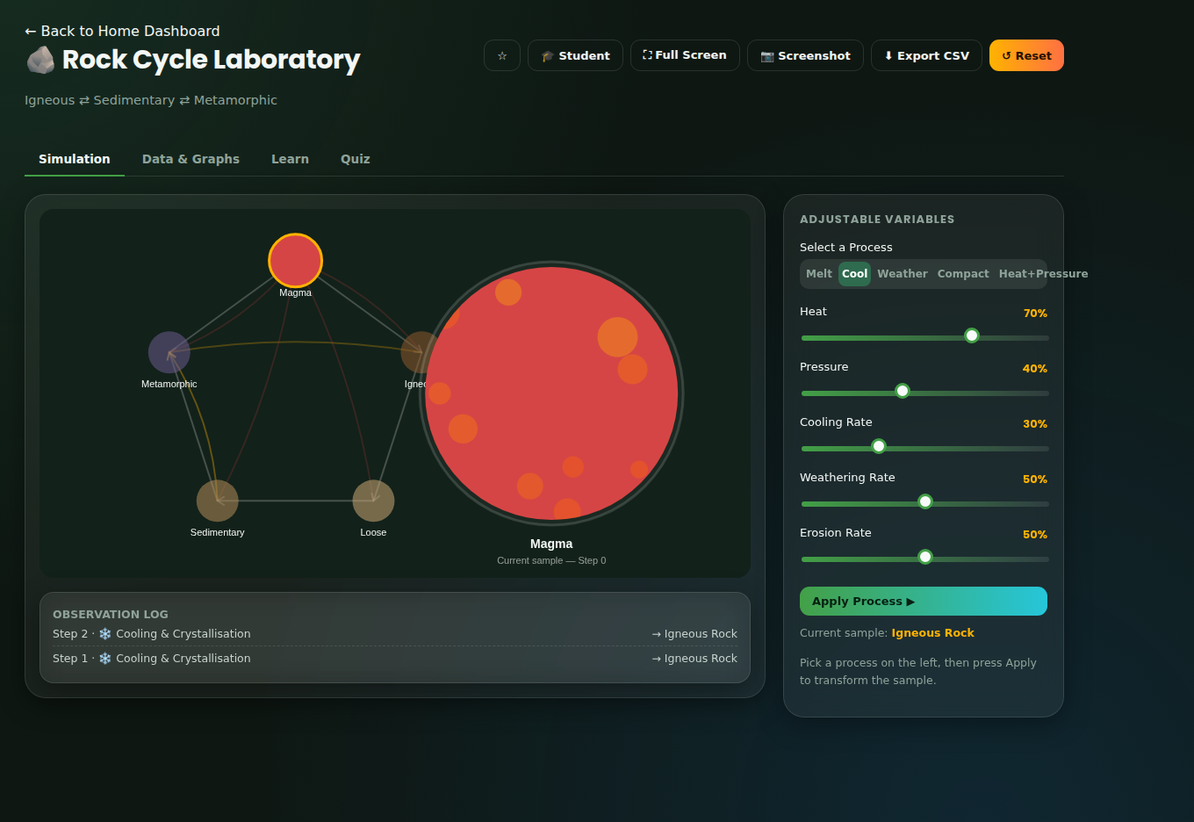
HOW TO USE — PART 2
Every simulation shares the same four-tab layout
Simulation
Data & Graphs
Learn
Quiz
Adjust sliders and switches on the right; watch the canvas and observation log respond live on the left.
Every logged trial feeds a live chart and a growing observation table — exportable as CSV.
Objectives, scientific background, real-world applications, common misconceptions, facts and a summary.
5 scored questions with instant right/wrong feedback and an explanation for each answer.
Toolbar on every simulation:
Bookmark — save for quick access later
Student / Teacher Mode — toggle extra guidance
Full Screen — for projectors and smart boards
Screenshot — capture the canvas as a PNG
Export CSV — download logged observations
Reset — return the simulation to its starting state
Rock Cycle Laboratory — the Simulation tab, with toolbar and observation log visible
VIRTUAL EARTH SCIENCE LABORATORY
08

Slide 9
CONSISTENCY BY DESIGN
What every one of the 10 labs includes
A single, predictable structure means students spend their attention on the science — not on relearning the interface each time.
Clear learning objectives
Scientific background
Adjustable real variables
Live canvas visualisation
Automatic observation log
Data table + live graph
Real-world applications
Common misconceptions
Interesting facts
5-question scored quiz
One-tap reset
CSV export & screenshot
VIRTUAL EARTH SCIENCE LABORATORY
09

Slide 10

PART TWO
The 10 Simulations
A guided tour of every interactive laboratory — what it teaches, what students control, and how it looks in action.
01 · Rock Cycle Laboratory
02 · Soil Formation Simulator
03 · Weathering Laboratory
04 · Erosion & Deposition Studio
05 · Fossil Formation Explorer
06 · Earthquake Waves Laboratory
07 · Volcano Formation Laboratory
08 · Plate Movement Explorer
09 · Mineral Formation Laboratory
10 · Earth's Geological Timeline Studio
VIRTUAL EARTH SCIENCE LABORATORY
10

Slide 11
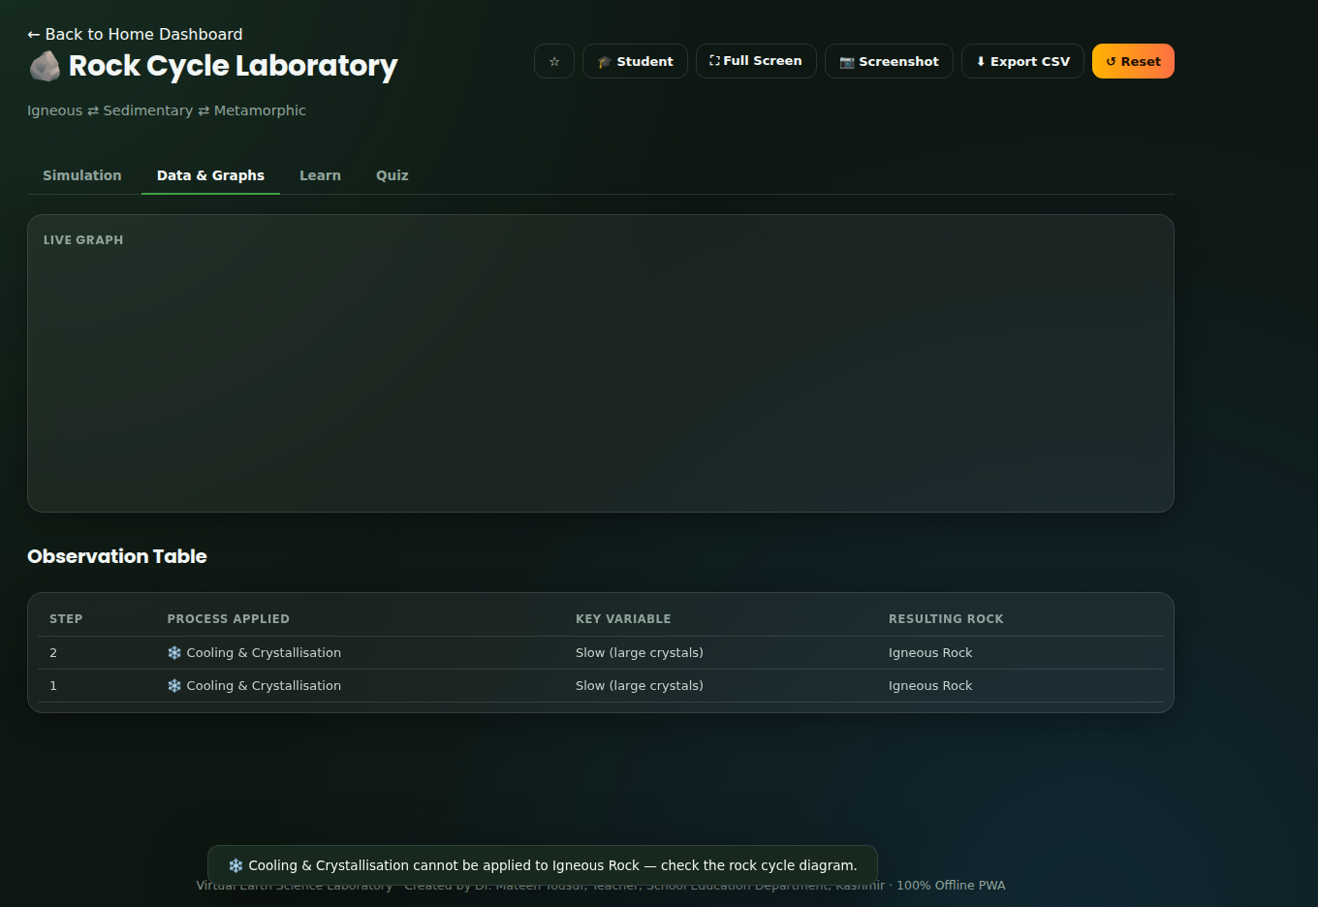
MODULE 01 OF 10 ROCKS CORE
Rock Cycle Laboratory
Igneous ⇄ Sedimentary ⇄ Metamorphic
WHAT STUDENTS INVESTIGATE
The rock cycle describes how igneous, sedimentary and metamorphic rocks continuously transform into one another through melting, cooling, weathering, erosion, compaction, cementation, heat and pressure — driven ultimately by Earth's internal heat and surface climate.
VARIABLES YOU CONTROL
Process: Melt · Cool · Weather · Compact · Heat+Pressure
Heat
Pressure
Cooling Rate
Weathering Rate
Erosion Rate
Simulation tab
REAL-WORLD RELEVANCE
Understanding the rock cycle helps geologists locate resources — for example, metallic ores associated with igneous intrusions, or fossil fuels trapped in sedimentary basins — and helps engineers judge how suitable a rock is as a building material.
5-question mini quiz · instant explained feedback · earns XP
Data & Graphs tab
VIRTUAL EARTH SCIENCE LABORATORY
11

Slide 12
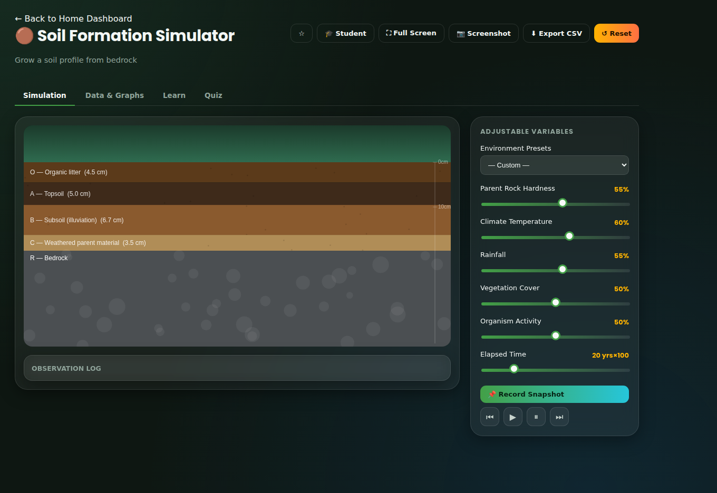
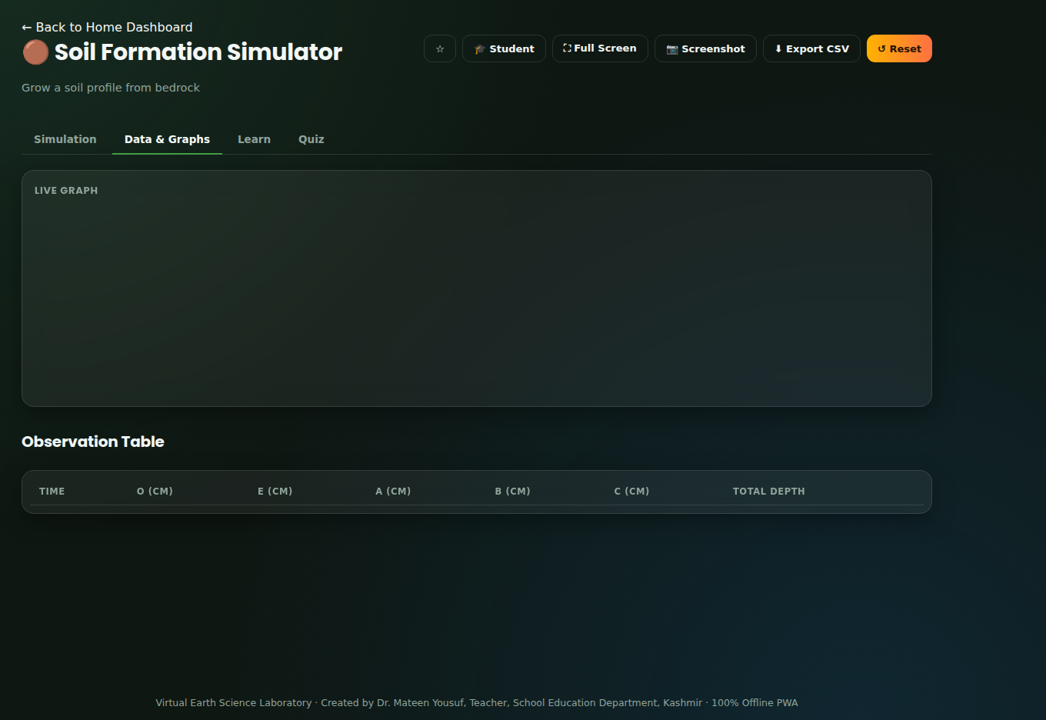
MODULE 02 OF 10 SOIL TIME
Soil Formation Simulator
Grow a soil profile from bedrock
WHAT STUDENTS INVESTIGATE
Soil horizons develop from bedrock through weathering, organic accumulation and leaching. Climate, vegetation, organisms, parent rock and time interact to determine how deep and how fertile a soil profile becomes — which is why identical bedrock can produce very different soils in different environments.
VARIABLES YOU CONTROL
Environment Presets (quick-load climates)
Parent Rock Hardness
Climate Temperature
Rainfall
Vegetation Cover
Organism Activity
Elapsed Time
Simulation tab
REAL-WORLD RELEVANCE
Understanding soil formation guides agriculture (choosing crops suited to soil depth and fertility), construction (foundation stability), and environmental management (predicting erosion risk on bare or degraded land).
5-question mini quiz · instant explained feedback · earns XP
Data & Graphs tab
VIRTUAL EARTH SCIENCE LABORATORY
12

Slide 13
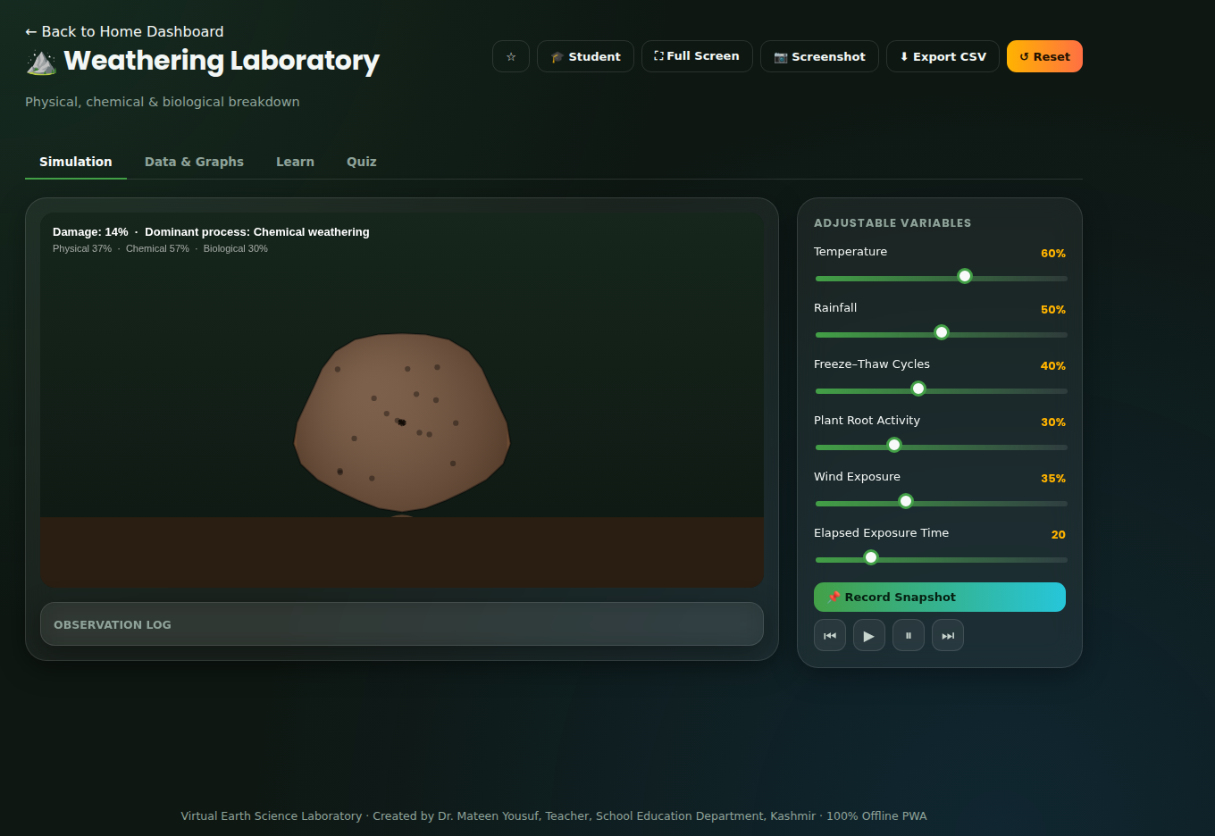
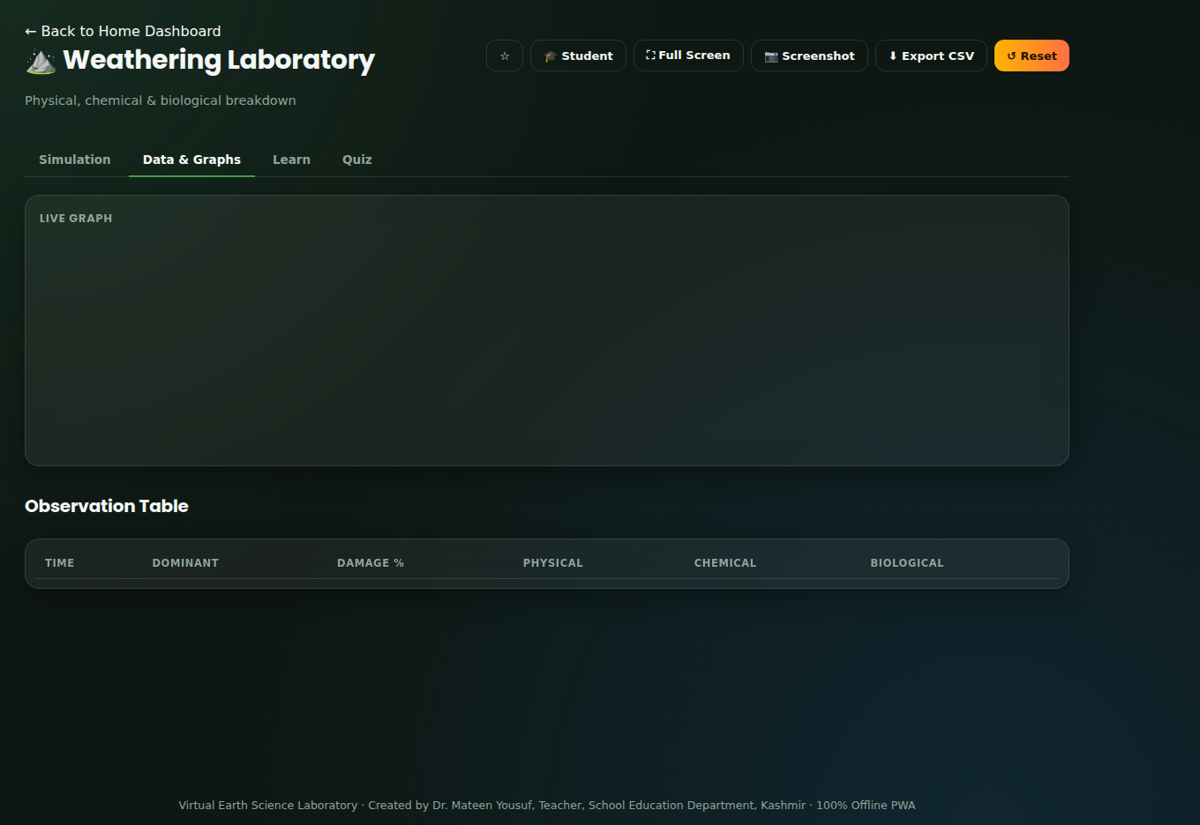
MODULE 03 OF 10 WEATHERING
Weathering Laboratory
Physical, chemical & biological breakdown
WHAT STUDENTS INVESTIGATE
Physical, chemical and biological weathering work together — often reinforcing each other — to break rock down in place. Climate largely determines which process dominates: cold regions favour physical (freeze–thaw) weathering, while warm, wet regions favour chemical weathering.
VARIABLES YOU CONTROL
Temperature
Rainfall
Freeze–Thaw Cycles
Plant Root Activity
Wind Exposure
Elapsed Exposure Time
Simulation tab
REAL-WORLD RELEVANCE
Engineers assess weathering risk before building on rock slopes or using stone in construction; conservationists monitor the chemical weathering of historic monuments caused by acid rain and pollution.
5-question mini quiz · instant explained feedback · earns XP
Data & Graphs tab
VIRTUAL EARTH SCIENCE LABORATORY
13

Slide 14
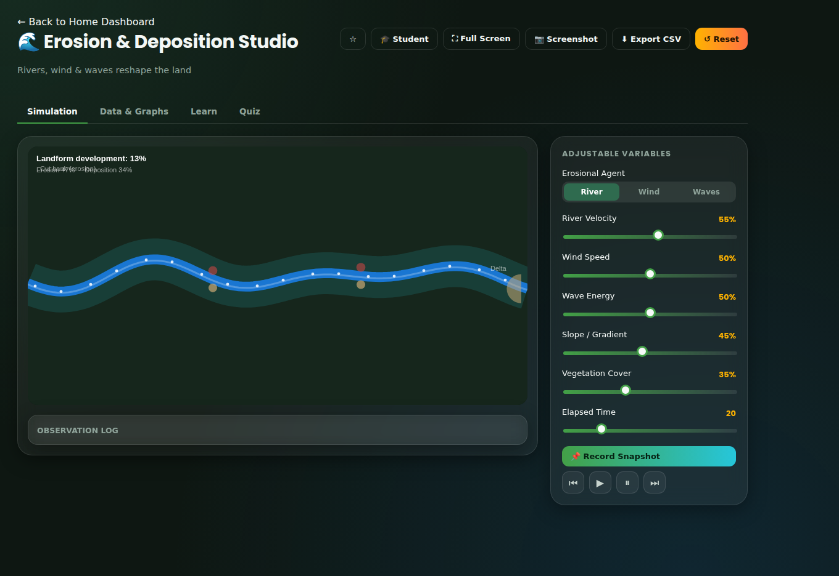
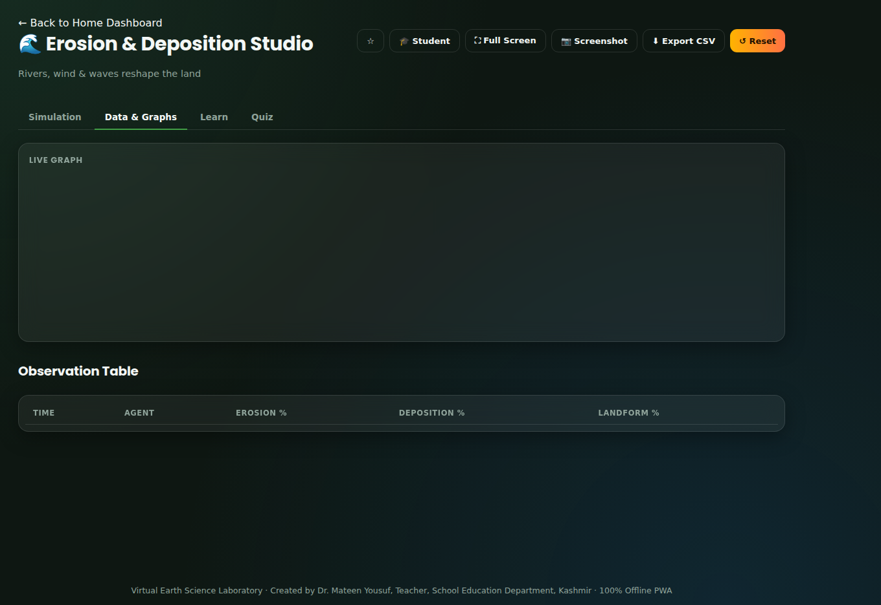
MODULE 04 OF 10 LANDFORMS
Erosion & Deposition Studio
Rivers, wind & waves reshape the land
WHAT STUDENTS INVESTIGATE
Erosion and deposition are two sides of the same process: energetic agents like fast rivers, strong winds and powerful waves erode material, then deposit it once they slow down or lose energy — continuously reshaping landscapes.
VARIABLES YOU CONTROL
Erosional Agent: River · Wind · Waves
River Velocity
Wind Speed
Wave Energy
Slope / Gradient
Vegetation Cover
Elapsed Time
Simulation tab
REAL-WORLD RELEVANCE
Understanding erosion and deposition helps engineers design river embankments and coastal defences, helps farmers prevent topsoil loss, and helps town planners avoid building on unstable dunes or actively eroding coastlines.
5-question mini quiz · instant explained feedback · earns XP
Data & Graphs tab
VIRTUAL EARTH SCIENCE LABORATORY
14

Slide 15
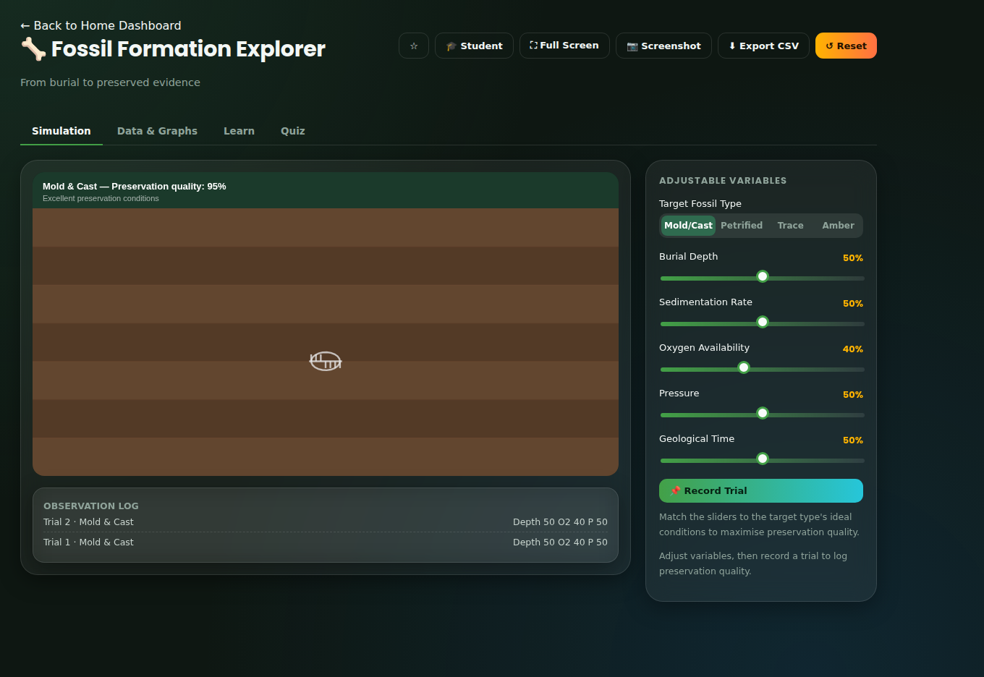
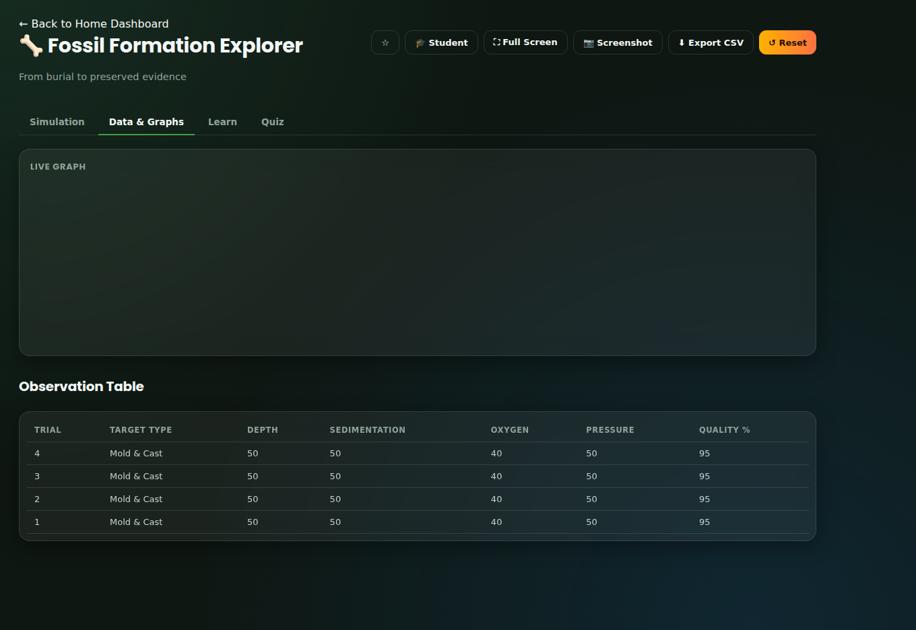
MODULE 05 OF 10 FOSSILS TIME
Fossil Formation Explorer
From burial to preserved evidence
WHAT STUDENTS INVESTIGATE
Fossilisation depends on a delicate balance of burial speed, oxygen levels, pressure and time. Matching these conditions to a specific pathway — mold and cast formation, petrification, trace fossil preservation, or amber entombment — determines what kind of fossil, if any, ultimately forms.
VARIABLES YOU CONTROL
Target Fossil Type: Mold/Cast · Petrified · Trace · Amber
Burial Depth
Sedimentation Rate
Oxygen Availability
Pressure
Geological Time
Simulation tab
REAL-WORLD RELEVANCE
Palaeontologists use fossil type and preservation quality to reconstruct ancient environments, and petroleum geologists use certain microfossils to date and correlate rock layers when searching for oil and gas.
5-question mini quiz · instant explained feedback · earns XP
Data & Graphs tab
VIRTUAL EARTH SCIENCE LABORATORY
15

Slide 16
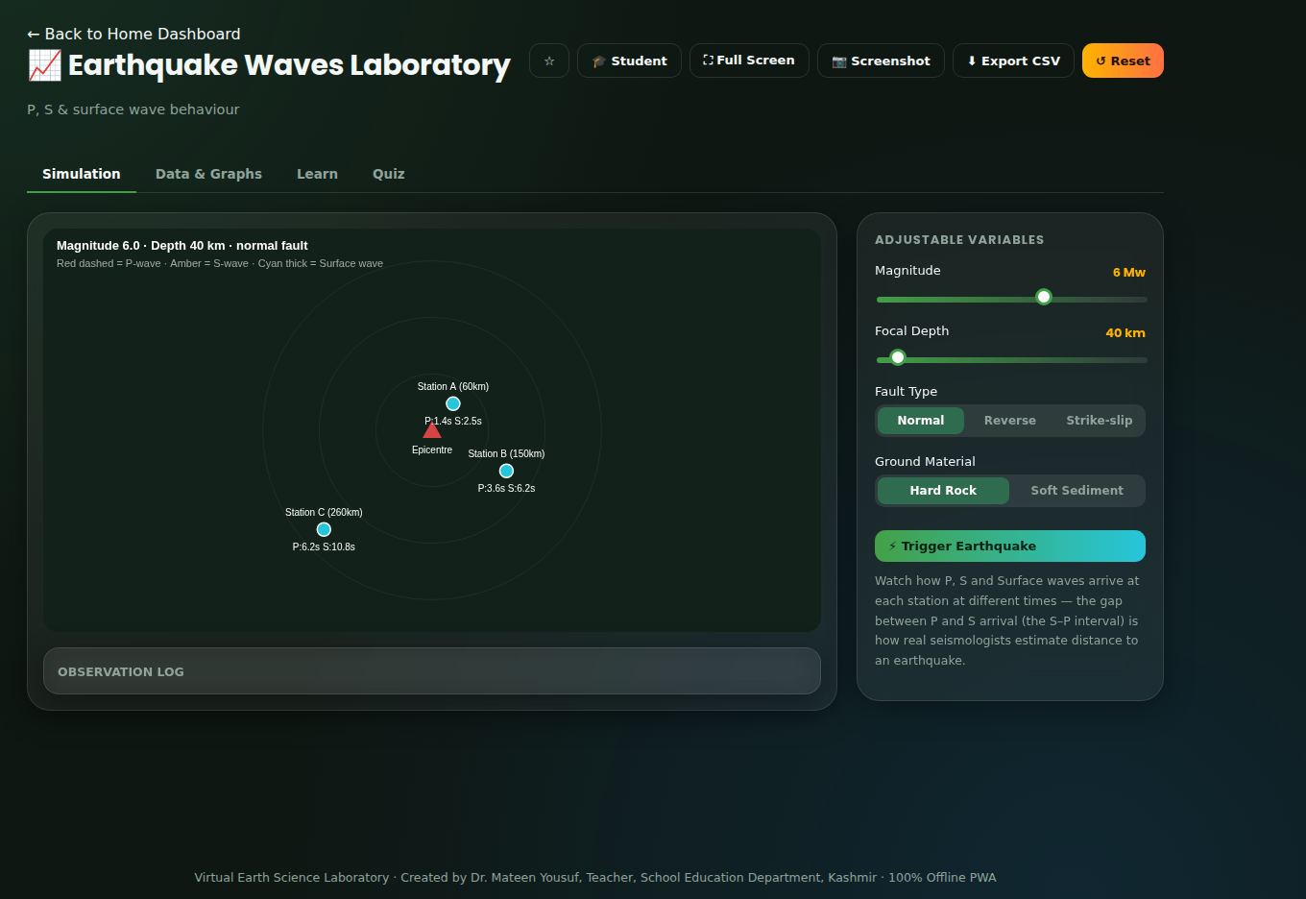
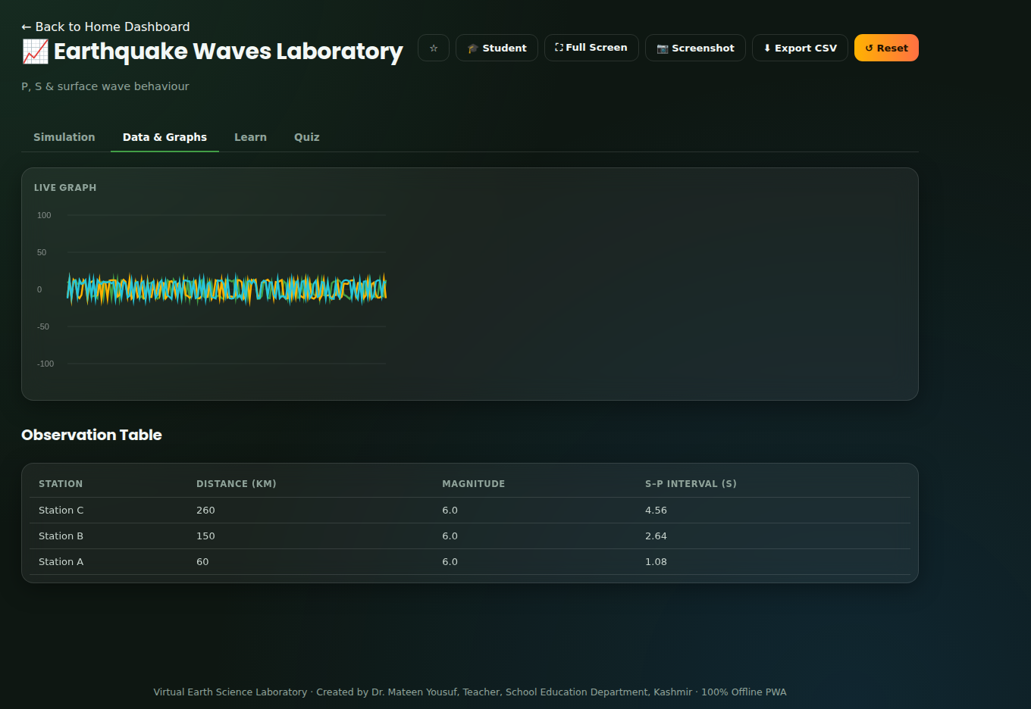
MODULE 06 OF 10 HAZARDS CORE
Earthquake Waves Laboratory
P, S & surface wave behaviour
WHAT STUDENTS INVESTIGATE
P-waves arrive first, S-waves second, and surface waves last but strongest. Comparing their arrival times at several seismic stations lets scientists locate an earthquake's epicentre and estimate its likely impact.
VARIABLES YOU CONTROL
Magnitude
Focal Depth
Fault Type: Normal · Reverse · Strike-slip
Ground Material: Hard Rock · Soft Sediment
REAL-WORLD RELEVANCE
Simulation tab
Seismologists use the arrival-time difference between P and S waves at multiple stations to triangulate an earthquake's location, and use magnitude and depth to estimate likely shaking intensity for early-warning systems.
5-question mini quiz · instant explained feedback · earns XP
Data & Graphs tab
VIRTUAL EARTH SCIENCE LABORATORY
16

Slide 17
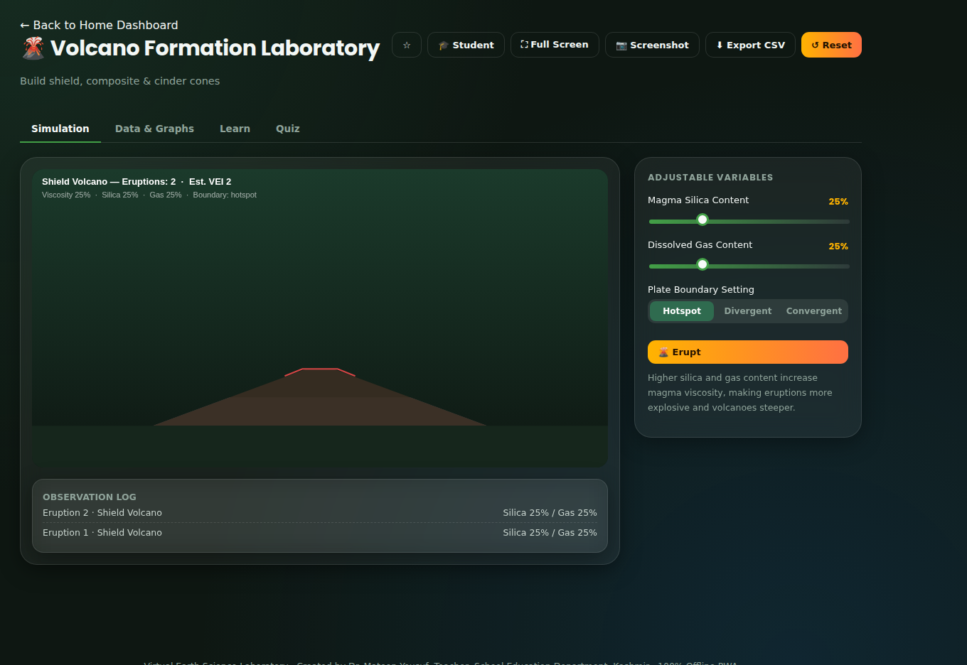
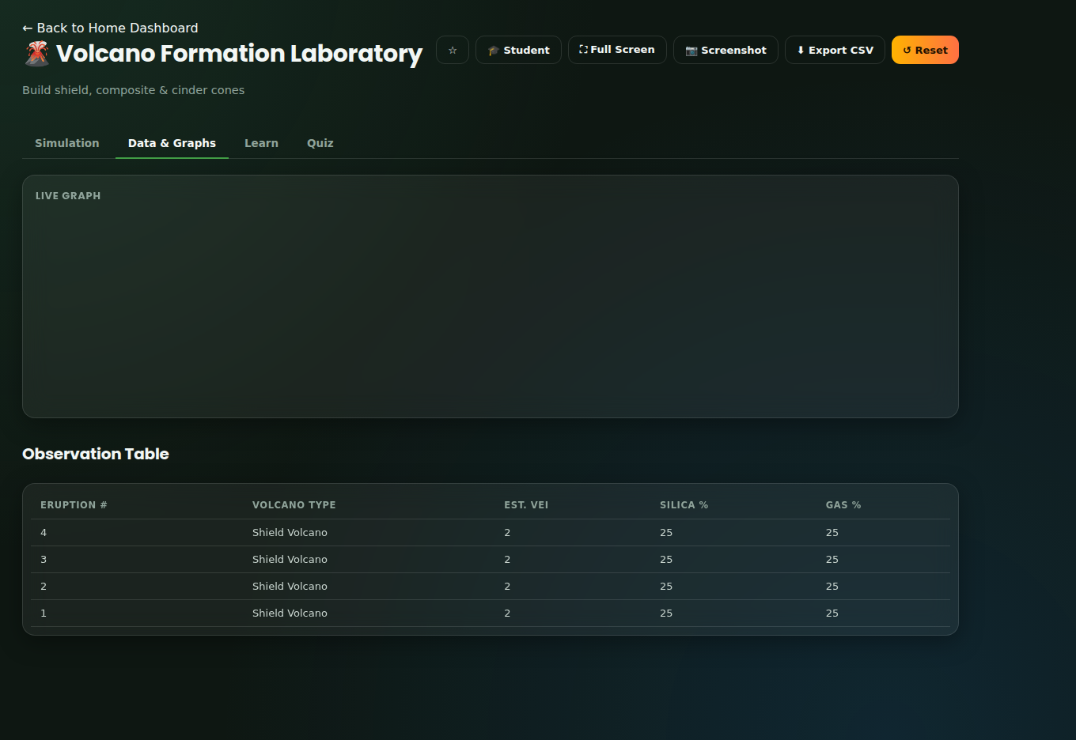
MODULE 07 OF 10 HAZARDS CORE
Volcano Formation Laboratory
Build shield, composite & cinder cones
WHAT STUDENTS INVESTIGATE
Magma composition and gas content control viscosity, and viscosity controls whether a volcano erupts gently or explosively — and whether it builds into a broad shield, a steep composite cone, or a small cinder cone.
VARIABLES YOU CONTROL
Magma Silica Content
Dissolved Gas Content
Plate Boundary Setting: Hotspot · Divergent · Convergent
REAL-WORLD RELEVANCE
Simulation tab
Volcanologists monitor gas emissions and ground deformation to forecast eruption style and warn nearby communities; understanding volcano type also guides land-use planning around active volcanoes.
5-question mini quiz · instant explained feedback · earns XP
Data & Graphs tab
VIRTUAL EARTH SCIENCE LABORATORY
17

Slide 18
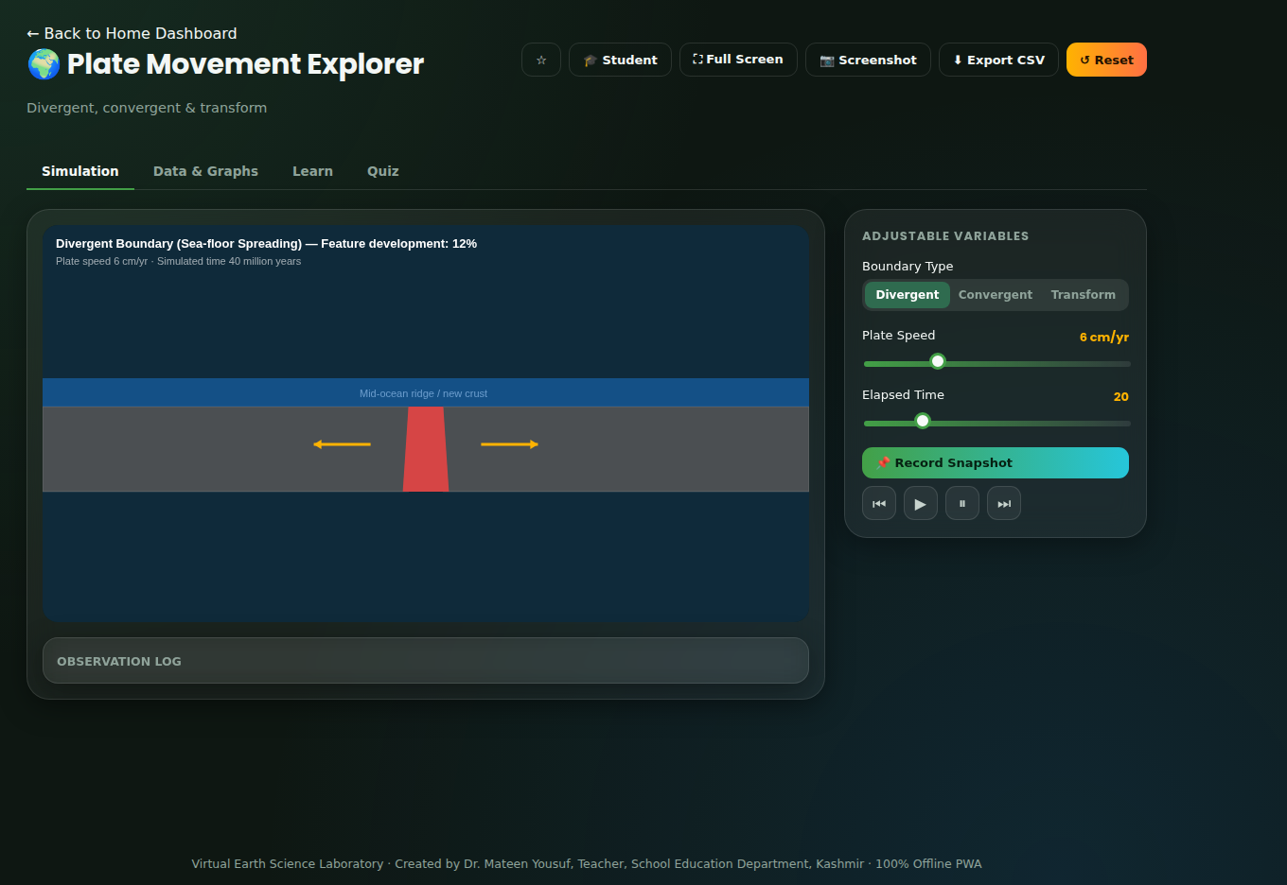
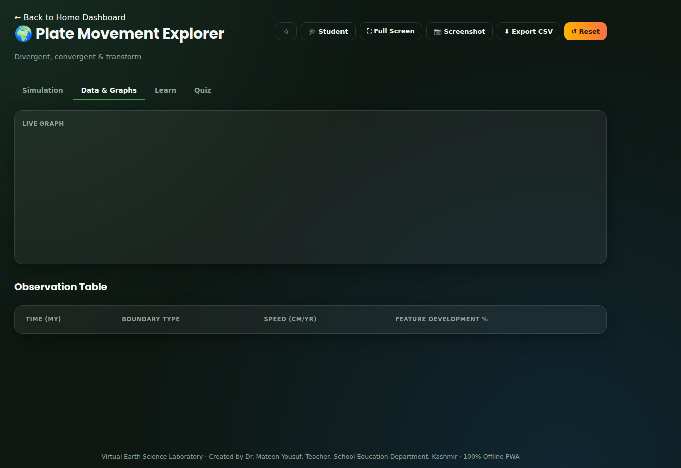
MODULE 08 OF 10 TECTONICS CORE
Plate Movement Explorer
Divergent, convergent & transform
WHAT STUDENTS INVESTIGATE
Divergent, convergent and transform plate boundaries each produce distinctive landforms and hazards, driven by the direction and type of plate motion — the same underlying process of mantle convection ultimately builds mountains, ocean basins and fuels earthquakes and volcanoes.
VARIABLES YOU CONTROL
Boundary Type: Divergent · Convergent · Transform
Plate Speed
Elapsed Time
REAL-WORLD RELEVANCE
Plate tectonics explains the global distribution of earthquakes, volcanoes and mountain ranges, and underpins hazard planning, mineral and petroleum exploration, and our understanding of continental drift over geological time.
Simulation tab
5-question mini quiz · instant explained feedback · earns XP
Data & Graphs tab
VIRTUAL EARTH SCIENCE LABORATORY
18

Slide 19
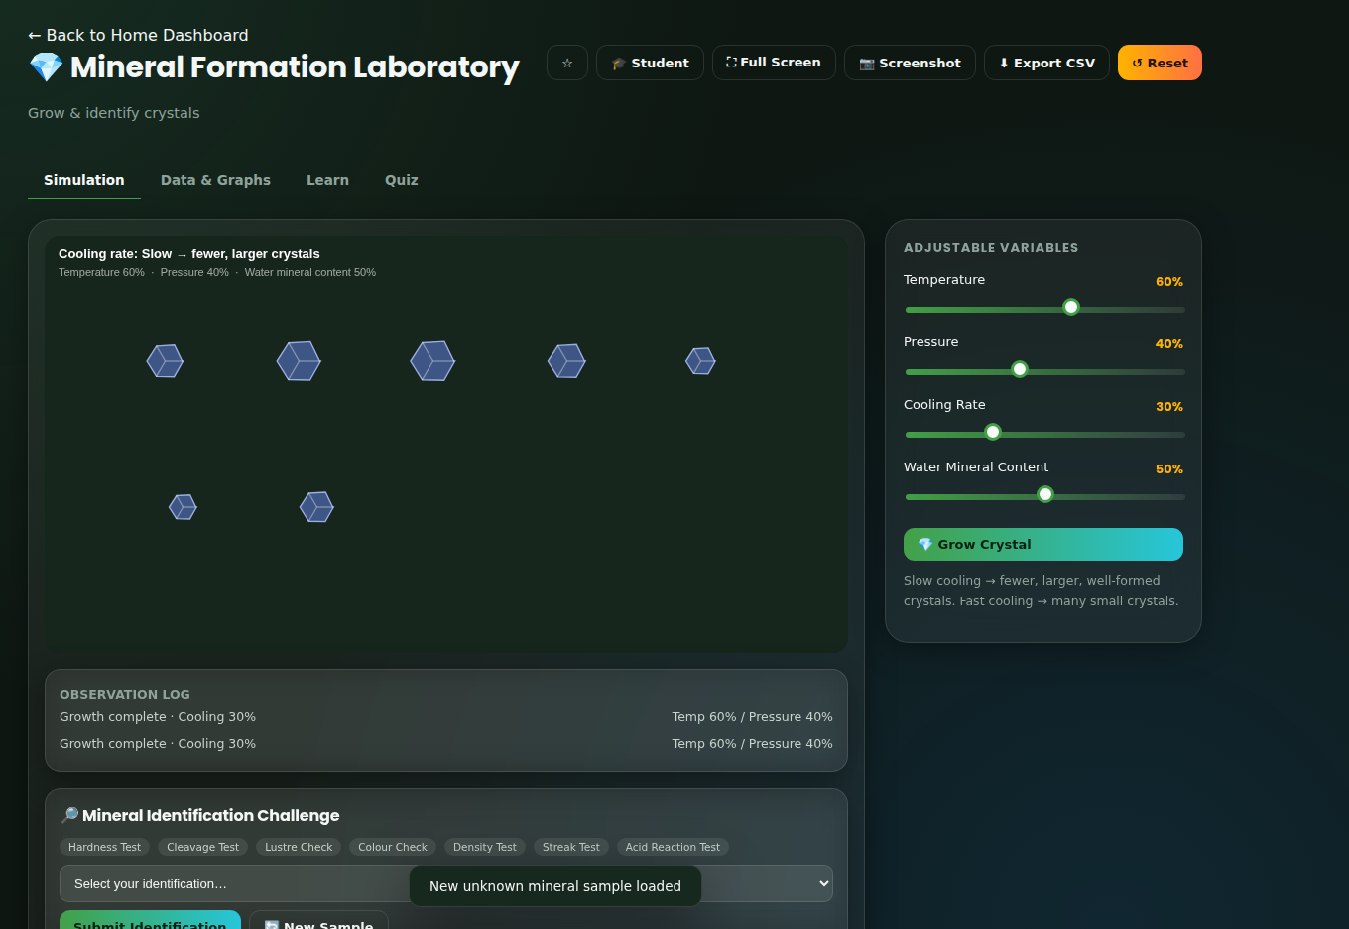
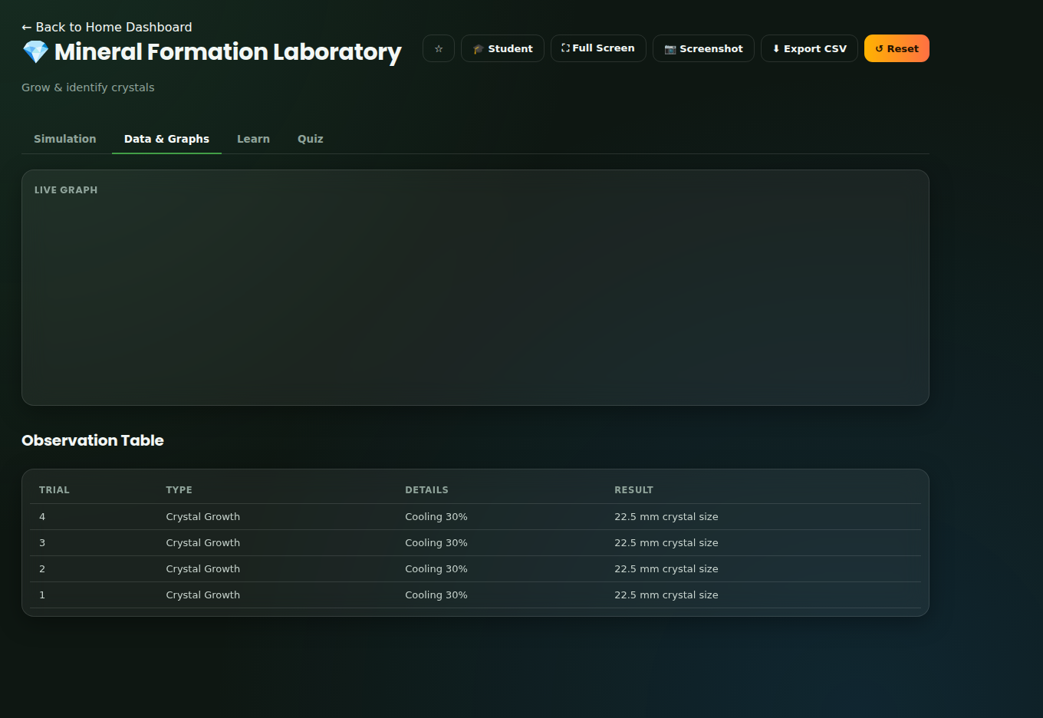
MODULE 09 OF 10 MINERALS
Mineral Formation Laboratory
Grow & identify crystals
WHAT STUDENTS INVESTIGATE
Temperature, pressure, cooling rate and water chemistry control how minerals crystallise, while a consistent set of physical properties — hardness, cleavage, lustre, colour, streak and density — lets scientists reliably identify them.
VARIABLES YOU CONTROL
Temperature
Pressure
Cooling Rate
Water Mineral Content
Simulation tab
REAL-WORLD RELEVANCE
Geologists use mineral identification to locate valuable ore deposits, gemologists use the same properties to grade gemstones, and material scientists apply crystal-growth principles to manufacture synthetic crystals for electronics.
5-question mini quiz · instant explained feedback · earns XP
Data & Graphs tab
VIRTUAL EARTH SCIENCE LABORATORY
19

Slide 20
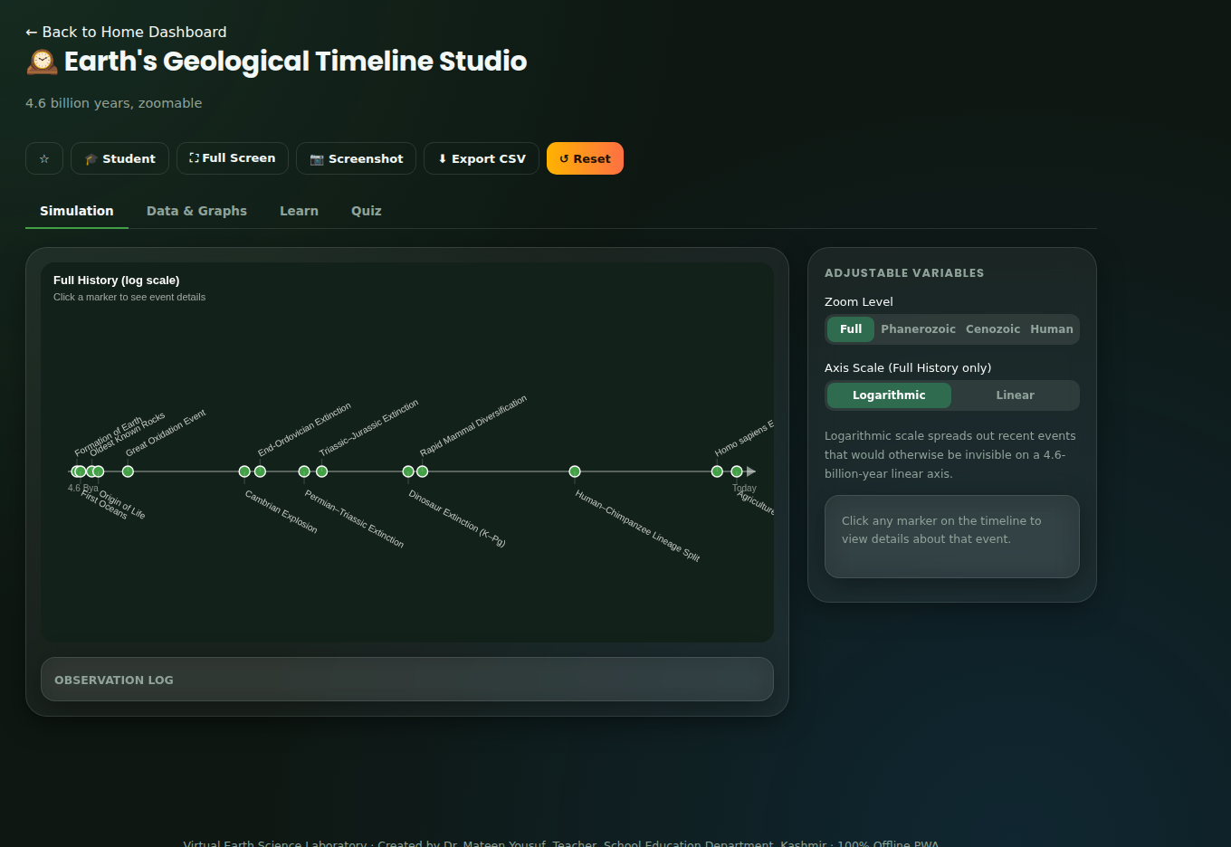
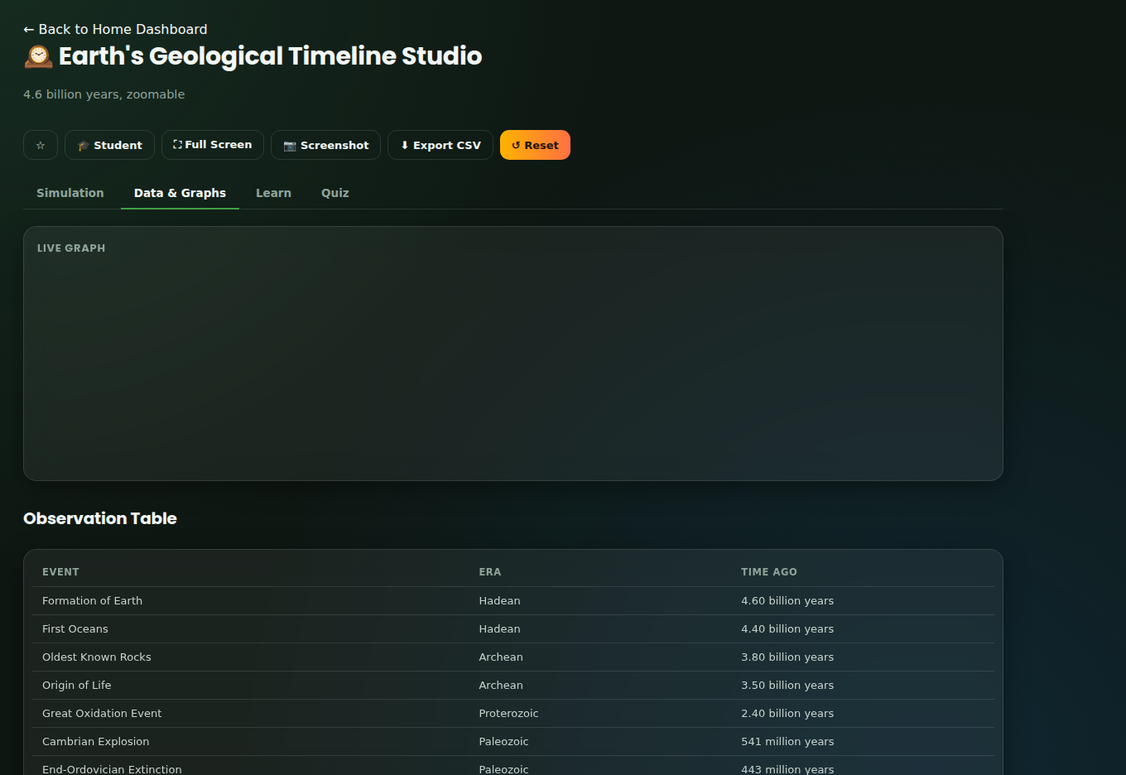
MODULE 10 OF 10 DEEP TIME CORE
Earth's Geological Timeline Studio
4.6 billion years, zoomable
WHAT STUDENTS INVESTIGATE
Geological time spans 4.6 billion years, organised by major boundaries such as the origin of life, the rise of atmospheric oxygen, the Cambrian explosion, repeated mass extinctions, and the very recent emergence of modern humans — best appreciated on a compressed or logarithmic timeline.
VARIABLES YOU CONTROL
Zoom Level: Full · Phanerozoic · Cenozoic · Human
Axis Scale: Logarithmic · Linear
Click any marker for event detail
REAL-WORLD RELEVANCE
Geological time scales let scientists correlate rock layers across continents, date the age of fossils and rocks, and understand the pace of processes like mountain building, mass extinctions and climate change.
Simulation tab
5-question mini quiz · instant explained feedback · earns XP
Data & Graphs tab
VIRTUAL EARTH SCIENCE LABORATORY
20

Slide 21
PART THREE
Beyond the Simulations
Reference and practice tools that support every lab: a handbook, a gallery, a glossary, a quiz centre and the gamification system that ties it all together.
VIRTUAL EARTH SCIENCE LABORATORY
21

Slide 22
REFERENCE TOOL
Earth Science Handbook
Ten illustrated reference chapters — Earth’s Structure, Rocks, Minerals, Soil, Plate Tectonics, Earthquakes, Volcanoes, Fossils, Geological Time, and Weathering & Erosion — give students a quick-reference companion to every simulation, always one tap away and fully searchable.
Concise, syllabus-aligned explanations for each topic
Written to match the exact concepts each lab teaches
Accessible from the sidebar on every screen
Works fully offline, like the rest of the app
VIRTUAL EARTH SCIENCE LABORATORY
22

Slide 23
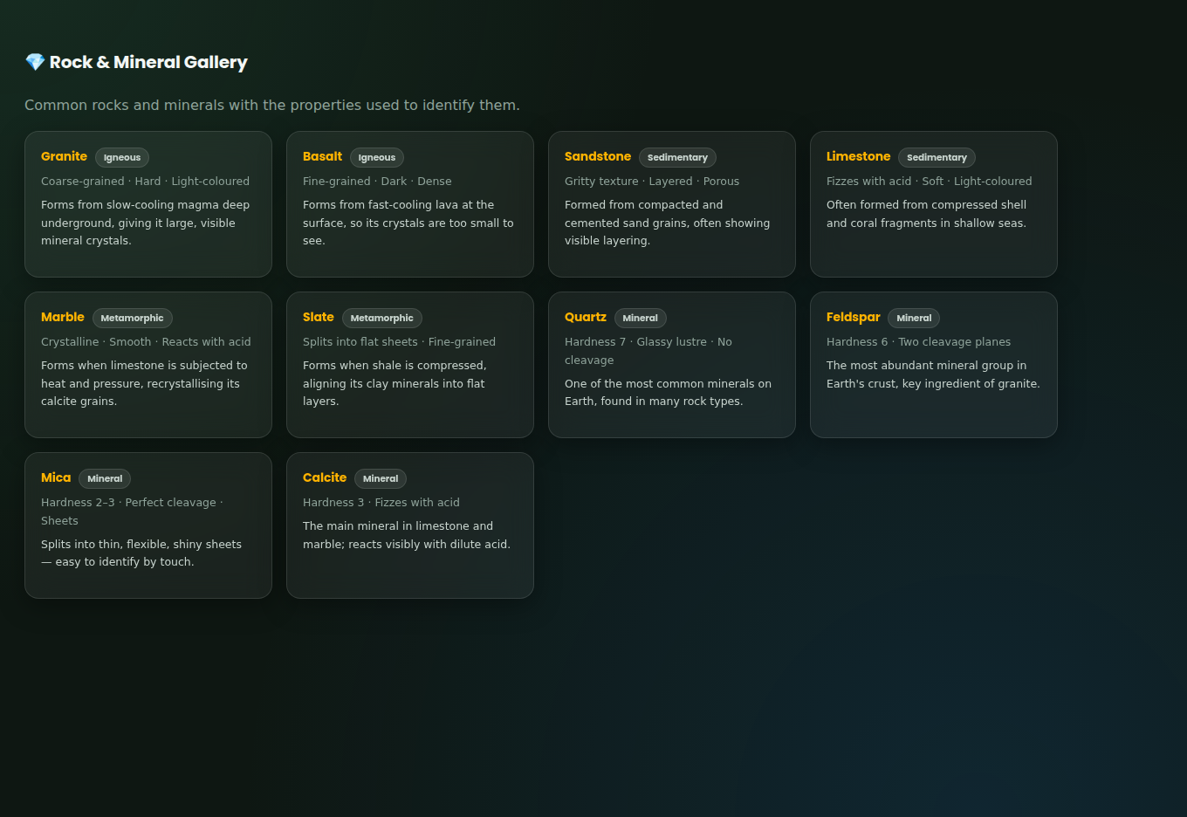
REFERENCE TOOL
Rock & Mineral Gallery
A browsable identification reference — common igneous, sedimentary and metamorphic rocks alongside key minerals — each with the physical properties (hardness, cleavage, lustre, colour, density) students need for hands-on identification, echoing the Mineral Formation Laboratory’s identification challenge.
Granite, basalt, sandstone, limestone, marble, slate
Quartz, feldspar, mica, calcite and more
Properties written the way a field guide would
Pairs directly with the Mineral Formation Laboratory
VIRTUAL EARTH SCIENCE LABORATORY
23

Slide 24
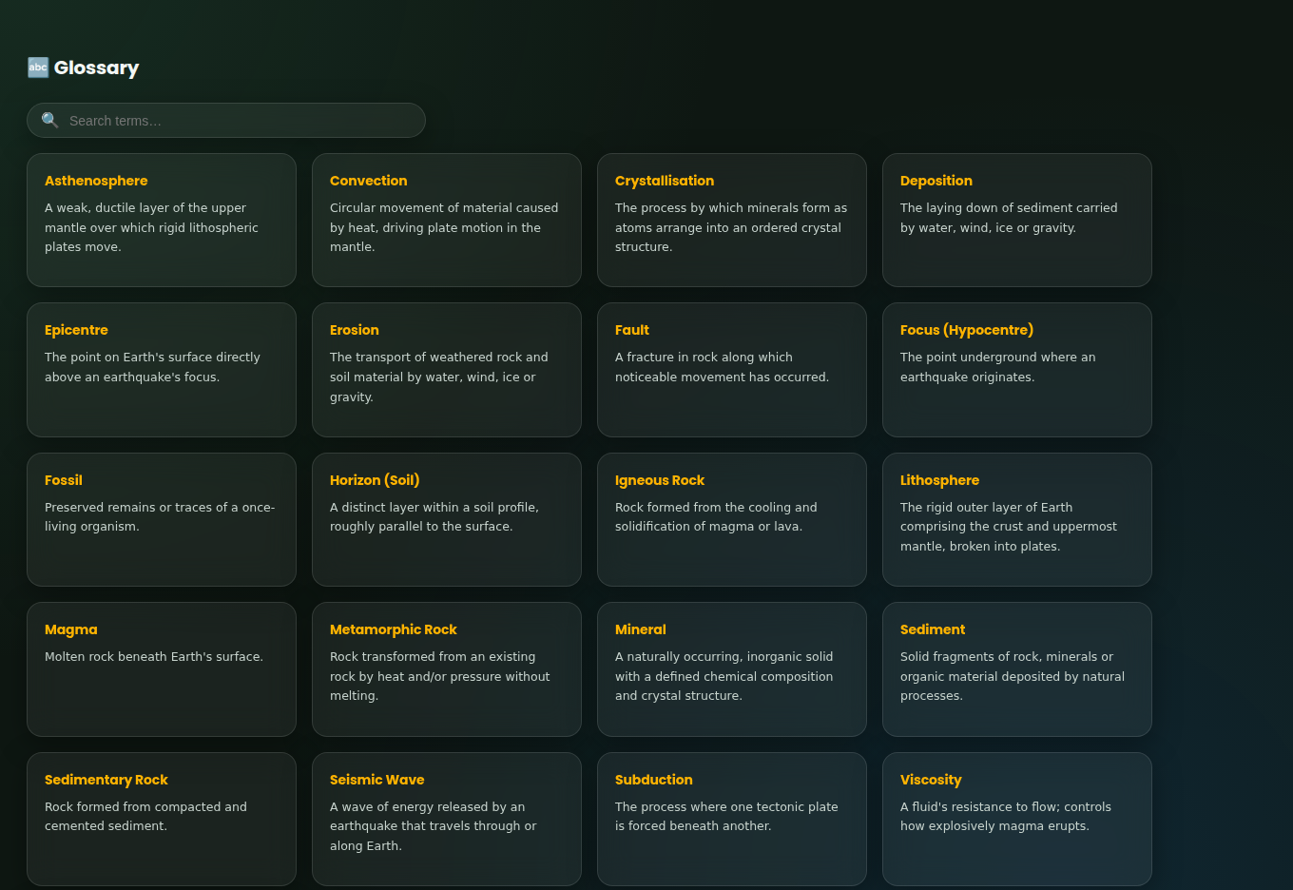
REFERENCE TOOL
Searchable Glossary
Over 20 key terms — from Asthenosphere to Weathering — defined in plain language and searchable instantly, so unfamiliar vocabulary never blocks a student mid-simulation.
Instant search-as-you-type filtering
Plain-language definitions, no jargon left unexplained
Covers terms used across all 10 simulations
Reinforces vocabulary tested in the quizzes
VIRTUAL EARTH SCIENCE LABORATORY
24

Slide 25
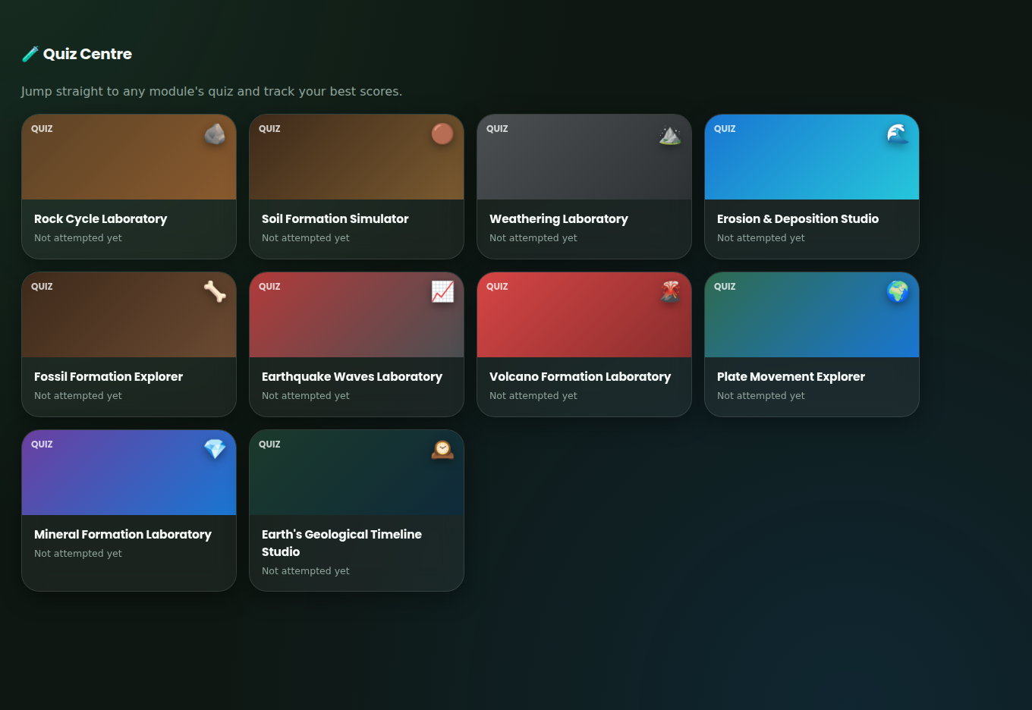
PRACTICE & MOTIVATION
Quiz Centre & Gamification
Every module’s quiz is also reachable directly from a central Quiz Centre, and every correct answer feeds a lightweight gamification layer that keeps students coming back to finish all ten labs.
XP
Earned from quiz answers and completed trials
Levels
Field Trainee through Chief Earth Scientist
Best Scores
Tracked per module and shown on each card
Completion Badges
“Completed” marker once a quiz is finished
VIRTUAL EARTH SCIENCE LABORATORY
25

Slide 26
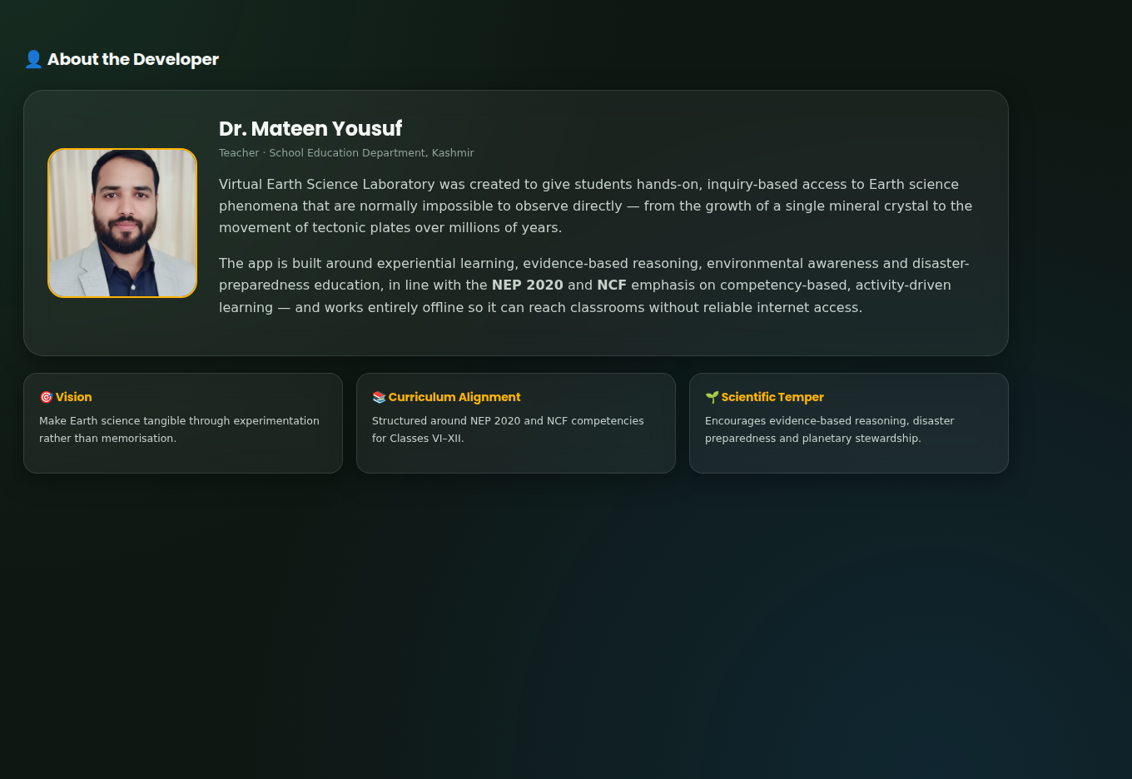
ABOUT
About the Developer
Dr. Mateen Yousuf Teacher, School Education Department, Kashmir
Virtual Earth Science Laboratory was created to give students hands-on, inquiry-based access to Earth science phenomena that are normally impossible to observe directly — from the growth of a single mineral crystal to the movement of tectonic plates over millions of years.
It is built around experiential learning, evidence-based reasoning, environmental awareness and disaster-preparedness education, in line with NEP 2020 and NCF — and works entirely offline so it can reach classrooms without reliable internet access.
VIRTUAL EARTH SCIENCE LABORATORY
26

Slide 27
CURRICULUM FIT
Aligned with NEP 2020 and NCF
Every simulation is framed around competency-based, activity-driven learning — the same principles at the heart of India’s National Education Policy 2020 and the National Curriculum Framework.
Competency-Based Learning
Experiential & Inquiry-Based
Scientific Temper
Students demonstrate understanding by doing — running experiments, not memorising facts.
Every lab starts with a question and a variable to test, not a passage to read.
Observation, evidence and reasoning are built into every quiz and data table.
Disaster Preparedness
Environmental Awareness
Classes VI–XII Coverage
Earthquake and volcano labs build real awareness of natural-hazard behaviour.
Erosion, weathering and soil labs connect directly to land and climate stewardship.
Content scales from an introductory to an exam-revision level across one app.
VIRTUAL EARTH SCIENCE LABORATORY
27

Slide 28
GETTING STARTED
Install it once, use it anywhere — no internet needed
1
2
3
4
Open the app
Look for “Install App”
Add to home screen
Turn off the network
Launch index.html in any modern browser, or open the installed shortcut.
In Settings, or via the browser’s own install/add-to-home-screen prompt.
One tap creates a real app icon — no browser address bar, no app store.
Every simulation, quiz, chart and reference page keeps working offline.
Why this matters for Kashmir’s classrooms
Built with zero backend and zero cloud dependency on purpose — once installed, the entire laboratory keeps working through connectivity gaps, in smart classrooms, and on shared devices with no data cost.
VIRTUAL EARTH SCIENCE LABORATORY
28

Slide 29

Thank You
Explore Earth’s dynamic systems — rocks, soil, hazards and 4.6 billion years of history — one variable at a time.
Virtual Earth Science Laboratory Created by Dr. Mateen Yousuf, Teacher, School Education Department, Kashmir
100% Offline · 10 Simulations · Classes VI–XII · NEP 2020 Ready

